Slide 1
PUBLIC SPEAKING
Catholic Robotics League Workshop and Scrimmage 2019

Slide 2
Why should I care?
Public speaking is a life skill that you will use wherever you go
Effective way of getting your message across to a large audience
Improves…
Communication skills
Leadership skills
Confidence
Ability to read and understand people

Slide 3
Building Good Habits
Don’t:
Fidget too much
Go off topic
Look at your feet/hands
Cross your arms
Ramble
Pick your nose
Do:
Make eye contact
Speak clearly
Project your voice
Include important information
Use an appropriate tone/vocabulary
Answer questions

Slide 4
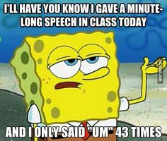
ACTIVITY: Filler Free
Find a partner that you do not know
Talk for 30 seconds without using any filler words
DON’T USE:
“um” “like” “uh” “y’know”
Your topic:
If you could have any superpower, what would you pick, and why?

Slide 5
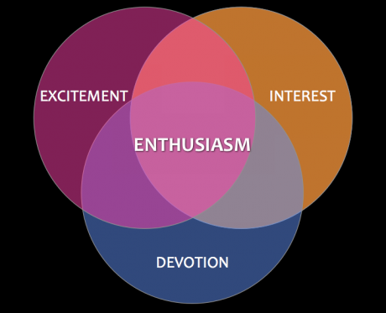
ACTIVITY: Enthusiasm
Get into groups of 4 people, that you do not know
Choose a topic that you really don’t like
It can be a TV show, movie, book, kitchen utensil, etc.
Only say positive things about this topic for 1 minute!

Slide 6
ACTIVITY: Projects
Find another group to join up with
Each person will give a 1 minute summary of what you’ve been working on
Use what you learned in the past two activities to help you
Think about:
What is the problem you’re solving?
What is some of your research?
Have you been building or coding?

Slide 7
It’s not just you!
Over 75% of the population struggles with a fear of public speaking
Here’s how to cope with any anxiety you may have:
Fake it ‘til you make it
Practice makes perfect
Breathe
Use the lessons you’ve learned today in not just your project presentations, but in your everyday life!

Slide 8
