Slide 1
Advanced Code
FLL workshops

Slide 2
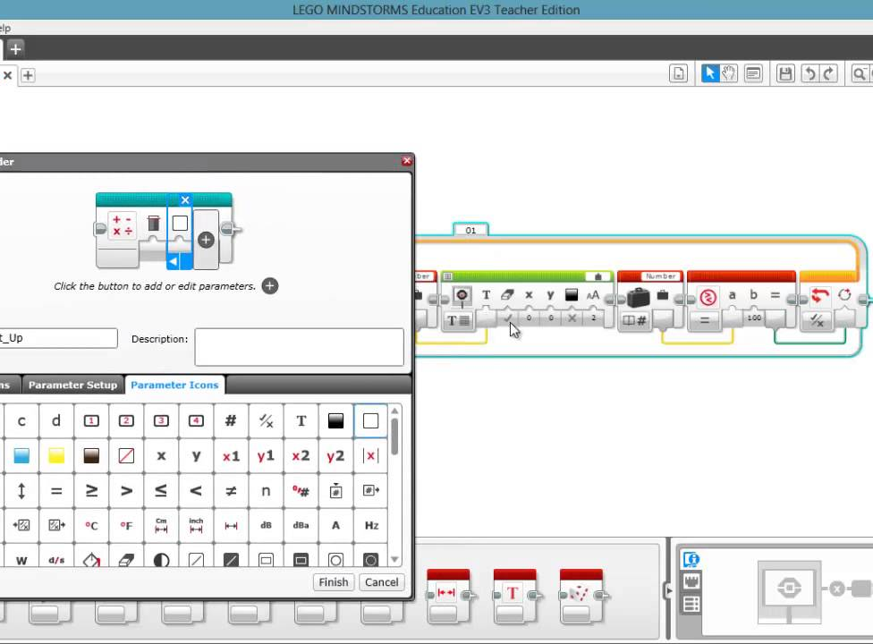
My Block
Why?
Saves time due to condensing code into one block that is easy to reuse
How?
After creating a section of code, select all blocks you want to include, and click the “Create my Block button”

Slide 3
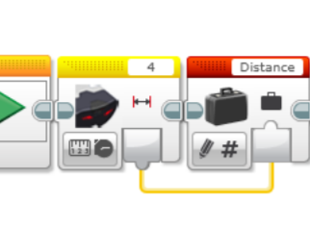
Data Hubs/Data Wires
Uses 3 Data Types
Integer, boolean, or text
Pass information between blocks
Broken Data Wire: grey dotted line that appears in place of wire when there connecting 2 different data types, giving an error
Notes:
http://www.stemcentric.com/nxt-data-hubs

Slide 4
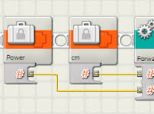
My Blocks using Data hubs
Allows My Blocks to get input from outside
Extra control over My Blocks code
Notes:
http://www.stemcentric.com/nxt-advanced-my-blocks
Control - i.e. can control how much a loop inside the My Block iterates

Slide 5
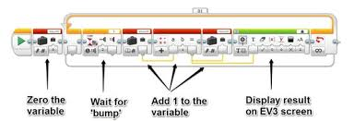
Variables
3 different kinds
Logic
Numbers
Text
Notes:
Logic is yes/no
Number: between -2billion and +2 billion
Text: letters and numbers all strung together
loops

Slide 6
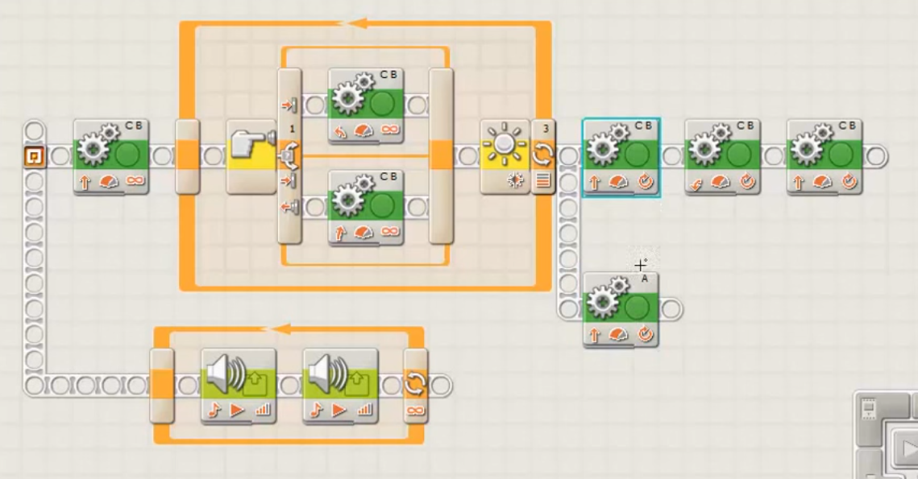
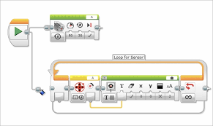
Multithreading
Connecting to lines of code, creating the ability to do multiple tasks at once

Slide 7
Challenge! Fancy Square!
Write a program for your robot to do the following:
Moves in a square
Plays a sound when turning
Uses a data hub to control how many times it moves around the square

