Slide 1
Project Workshop
CRL Scrimmage and Workshop 2019
Notes:
Sources:
http://www.firstlegoleague.org/sites/default/files/into-orbit/first-lego-league-rubrics.pdf
https://www.first-lego-league.org/en/season//research-project.html
https://www.first-lego-league.org/en/preseason/research-project/evaluation.html

Slide 2
Outline
Project + Objectives
Design Process Best Practices
Evaluate Mock Project
Review

Slide 3
What is the Research Project?
In the Innovation Project, your team will:
Identify a problem with a building or public space in your community.
Design a solution.
Share your solution with others and then refine it.
At official events, your team will present your Project, including the problem, your solution, and how you shared it, in a 5-minute presentation.

Slide 4
Project Objectives
The award is given to the team, which presents:
a child-suitable “high-quality” research,
an innovative solution,
a profound understanding of the different aspects of their research and
a creative presentation.
How will FIRST evaluate your project?
understood and shows all aspects of the problem
analyses the effects, despite of not having solved the problem
working out a solution including robot technology
presentation attracts the attention of the jury

Slide 5
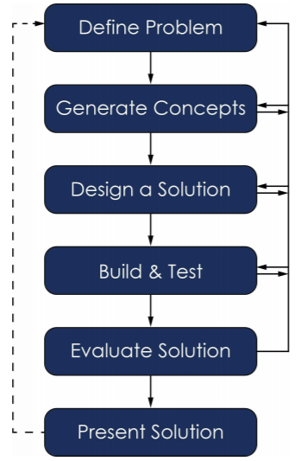
Design Process
Define a Problem
Generate Concepts
Develop a Solution
Build and Test a Prototype
Evaluate the Solution
Present the Solution

Slide 6
What makes a “good problem”?
Something you are interested in solving
Affects a wide variety of people
Determine possible causes
Addresses a need

Slide 7
Ideas, Ideas, Ideas!
Users
Criteria + Constraints
Research
Brainstorm
Decision Matrix
Notes:
First, you will identify what we call your criteria and constraints and who is using your product. Criteria are the needs you must meet. For example, if you are asked to design a roller coaster, it will have be safe and comfortable. Constraints are the limits you must work around. For example, you may be asked to make your roller coaster below a certain height for safety reasons. Also consider what audience you are solving a problem for. For example, if it is a product for babies you will know that your constraints will include “no small parts”.
Once you have identified these, you can begin research. When designing something, you will want to look at previous solutions to your problem, and identify any flaws in that approach. This can also help with generating ideas for your own design.
Finally is the the fun part… brainstorming!
A few tips on brainstorming: brainstorm as a group, the more ideas the better, no idea is a bad idea, don’t make anyone feel bad about sharing their idea, create as many as possible even if you don’t think they are all good. I would like to especially emphasize that NO IDEA IS A BAD IDEA. Even if it’s so out of this world, a crazy idea may spark a conversation and lead to an amazing result. Innovation starts with crazy ideas!
Decision Matrix is a clear way to decide the best design. This approach is often used because it fully takes out personal opinion. The way it works is on one side, you have your possible designs, and the other your criteria/constraints. You then rate your designs on a scale based on these requirements.
Even though it’s not as fun as building, a thorough design decision will pave the way for an extraordinary project!

Slide 8
Designing Your Solution
Design solution
Drawings/CAD (plan)
Prototype: A full-scale working model used to test your design

Slide 9
Evaluate!
Does your solution work?
What can be improved next time?
Engineering is an “iterative” process

Slide 10
Formal presentation
Present your final solution and describe the process
Project Portfolio
Final step

Slide 11
