Slide 1
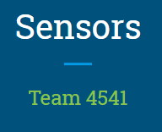
Notes:
https://docs.google.com/presentation/d/1rhxv7LhteAekeAXFa4cdHELCzhTq33X_3xXh3rdd5rY/edit#slide=id.g48152fa9e3_0_0

Slide 2
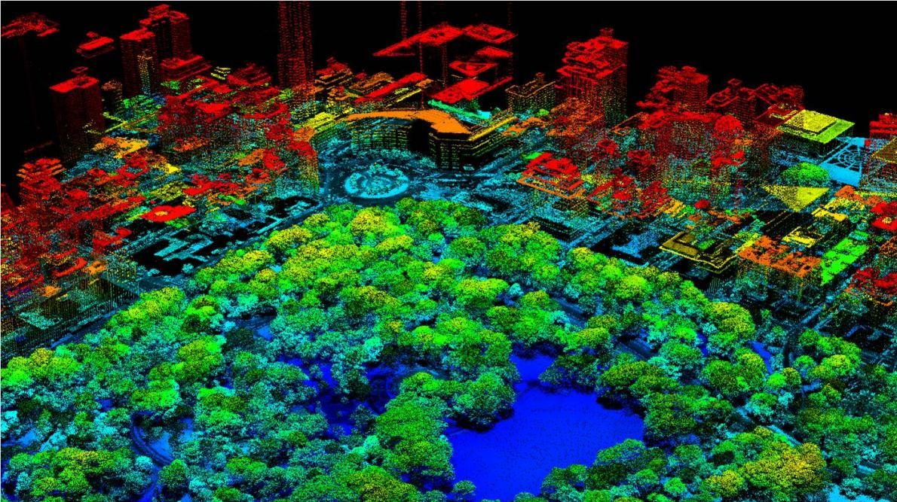
What is a sensor?
Notes:
Ask for a volunteer
Blindfold one student who is the robot
The rest of the students have to direct the person through a maze of desks
Time how long it takes with no assistance
Put velcro on one desk (introduce new sense)
Time again
Take off blindfold
Time again
discuss

Slide 3
Goal: Reach door without hitting obstacles
Notes:
What kind of sensors do we need for this?
Ultrasonic

Slide 4
https://www.google.com/search?q=google+stopwatch&rlz=1C1EJFA_enUS780US780&oq=google+sto&aqs=chrome.0.69i59j0l2j69i57j0j69i60.2428j1j7&sourceid=chrome&ie=UTF-8

Slide 5
What kinds of sensors do you use?
Notes:
What kind of sensors do we need for this?
Ultrasonic

Slide 6
Who is ready to try it?
Please open a new EV3 project
Notes:
What kind of sensors do we need for this?
Ultrasonic

Slide 7
Goal: Turn motor on with touch sensor
Notes:
What kind of sensors do we need for this?
Ultrasonic

Slide 8
Notes:
What kind of sensors do we need for this?
Ultrasonic

Slide 9
Goal: Turn motor on and off with touch sensor
Notes:
What kind of sensors do we need for this?
Ultrasonic

Slide 10
Notes:
What kind of sensors do we need for this?
Ultrasonic

Slide 11
Goal: Stop when the wall is 20cm away
Notes:
What kind of sensors do we need for this?
Ultrasonic

Slide 12
Notes:
What kind of sensors do we need for this?
Ultrasonic

Slide 13
Goal: Follow the black line
Notes:
What kind of sensors do we need for this?
Ultrasonic

Slide 14
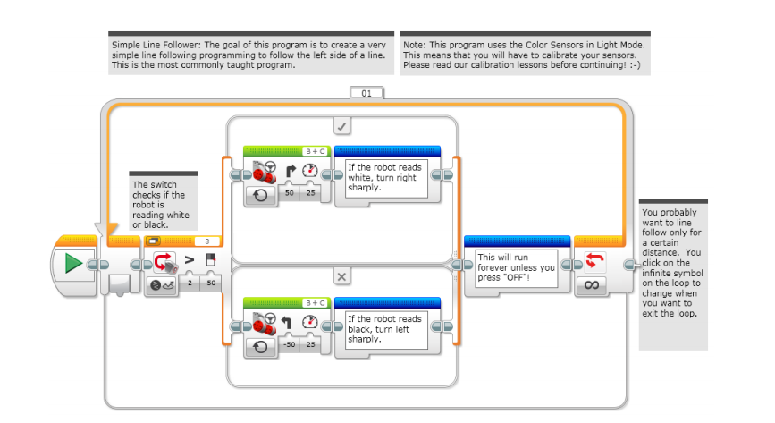
Notes:
What kind of sensors do we need for this?
Ultrasonic

Slide 15
What do you want to use sensors for?

Slide 16
Resources
http://www.legoengineering.com/how-to-toggle-a-motor-on-off-with-a-touch-sensor/
https://education.lego.com/en-us/lessons/mindstorms-ev3/object-detection#Planitem1

